Slide 1
FOOD TRENDS: Based on Customer Satisfaction
TEAM-05
Under the Guidance:
Pavithra Kannan mam

Slide 2
TEAM MEMBERS:
01
Hema Latha
02
Samvedita Bisariya
03
Dipa Majumder
04
Udit Mathur

Slide 3
Overview: Product/Feature Performance & Advanced Analytics
Objective: Analyze the performance of individual products and key features using advanced DAX measures and interactive data visualizations.
Key Activities:
Developed custom DAX measures to evaluate sales, revenue, customer sentiment, and product ratings at a detailed level.
Created calculated columns and aggregation formulas to track loyalty, feature-level satisfaction, and product ranking.
Built a comprehensive Power BI dashboard allowing dynamic exploration of operational efficiency, feature quality, and revenue drivers.
Outcome: Uncovered actionable insights to guide business decisions, such as improving service where wait times are high, promoting top-rated features, and targeting segments with strong loyalty or sales growth.

Slide 4




Core DAX Measures for Insights
1. Revenue & Volume:
Total Revenue
Total Visits
Distinct Customers
Average Spend per Visit

Slide 5





Core DAX Measures for Insights
2. Feature Aggregates:
Avg Food Rating
Avg Service Rating
Avg Ambiance Rating
Avg Overall Rating
Product Feature Score
(combined product scores)

Slide 6
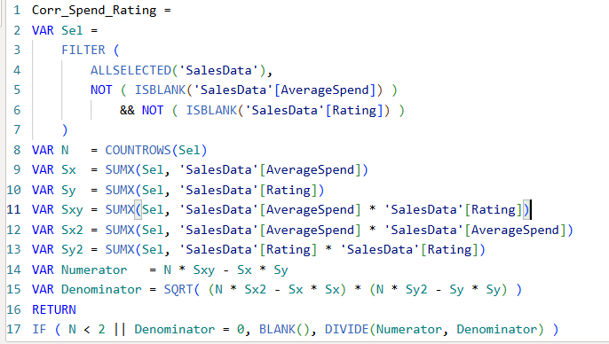
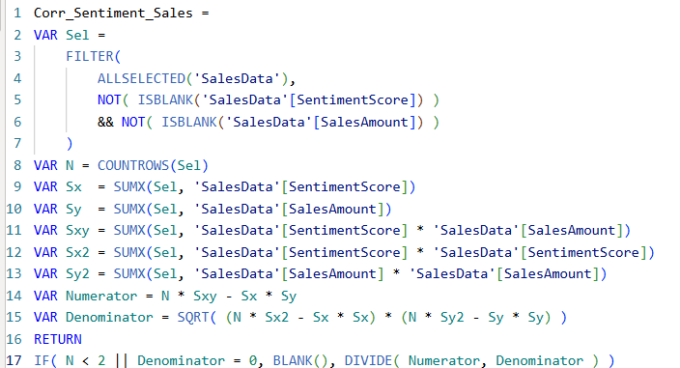
Core DAX Measures for Insights
3. Correlations:
Corr_Spend_Rating Corr_Sentiment_Sales
(correlation between spend and ratings) (correlation between sentiment and sales)

Slide 7
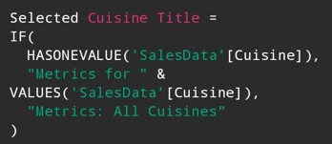
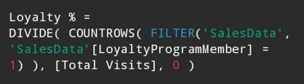

Core DAX Measures for Insights
4. Segmentation & Dynamic Titles:
Selected Cuisine Title (Dynamic Title)
Create a measure to display the selected cuisine in the slicer dynamically or show "All Cuisines" if none selected.
Loyalty %
Revenue Rank
Measure to rank cuisines by total revenue descending.

Slide 8
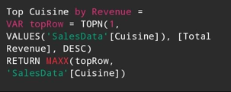

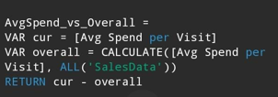
Core DAX Measures for Insights
4. Segmentation & Dynamic Titles:
Top Cuisine by Revenue
Cuisine % of Revenue
Calculates the percentage revenue share per cuisine.
AvgSpend_vs_Overall
Compares average spend per visit for each cuisine versus overall average

Slide 9
5. Power BI Visual Built:
Overview KPIs (Top Row):
Average Rating: Overall product/customer satisfaction average score.
Average Sentiment: Average customer sentiment score from reviews.
Total Sales: Total revenue generated from all cuisines and visits.
Total Reviews: Total number of customer reviews collected.
(B) Filters & Segmentation (Left):
Gender and Cuisine Filters: Enable dynamic filtering of all visuals on the dashboard so the user can focus on a specific customer segment or cuisine type.
Feature Ratings (Grouped Bar Chart):
Displays average food, ambiance, and service ratings by cuisine.
Helps compare key satisfaction dimensions across cuisines.
Supports identifying strengths and weaknesses in product/experience.

Slide 10
(D) Sentiment vs Sales (Scatter Plot):
Examines relationship between average customer sentiment and total sales by cuisine.
High sentiment correlating with higher sales signals customer satisfaction driving revenue.
(E) Sales vs Customer Sentiment (Stacked Bar Chart):
Breakdown of positive, neutral, and negative reviews proportions across cuisines.
Gives quick insight into customer satisfaction distribution within each cuisine segment.
(F) Revenue Share (Pie Chart):
Shows market share of revenue by cuisine.
Visualizes business contribution of each cuisine to total revenue.
(G) Average Wait Time (Bar Chart):
Highlights average service wait time by cuisine.
Useful operational metric for identifying areas needing service improvement.

Slide 11
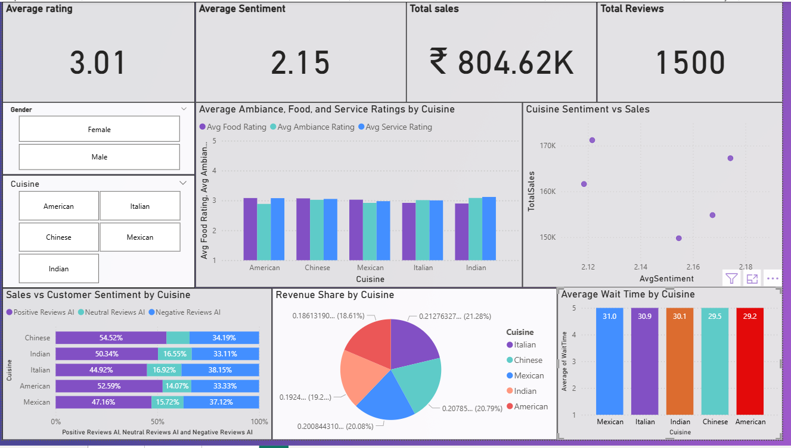
OUTPUT:

Slide 12
Business Value
Enhanced Decision-Making:
The dashboard consolidates diverse data streams into intuitive visuals, enabling faster and more informed strategic and operational decisions.
Improved Customer Experience:
By tracking satisfaction metrics and loyalty, businesses can identify strengths and improvement areas, driving higher customer retention and revenue.
Operational Efficiency:
Insights like wait times, sales distribution, and ranking allow targeted resource allocation, optimizing service levels and profitability.

Slide 13
CONCLUSION
Comprehensive Analysis: The project delivers a holistic view combining sales, customer feedback, operational, and loyalty data for actionable insights.
Custom Measures & Visuals: Advanced DAX calculations and intuitive visuals make complex data easily understandable and actionable.
Business Impact: The insights from this dashboard support targeted strategies to improve customer satisfaction, operational performance, and business revenue.
Future Scope: The framework allows easy addition of new measures/visuals for continuous improvement and deeper analytics, ensuring long-term value.

Slide 14
THANK YOU

